Slide 1
Data Structure and Algorithms (Honor Track) Lecture 1: Course Intro & Basics
主讲教师: 黄群
huangqun@pku.edu.cn

Slide 2

Schedules
Class (二教 527)
Wed. 10am-12pm
Fri. 8am-10am
Office 理科1号楼1808
by appointment
(email or wechat)
Teaching assistants
张乐行：
2301112101@pku.edu.cn

Slide 3
Course Contents
List, stack, queue; string
Binary trees, trees, forests
Graphs
Internal & external sorting
Indexing and search
Advanced data structures and algorithms

Slide 4
Textbooks
Mark Allen Weiss:《数据结构与算法分析—C++描述(英文版第3版)》
ISBN 7-115-15233-0
张铭/王腾蛟/赵海燕:《数据结构与算法》
ISBN 9787040239614

Slide 5
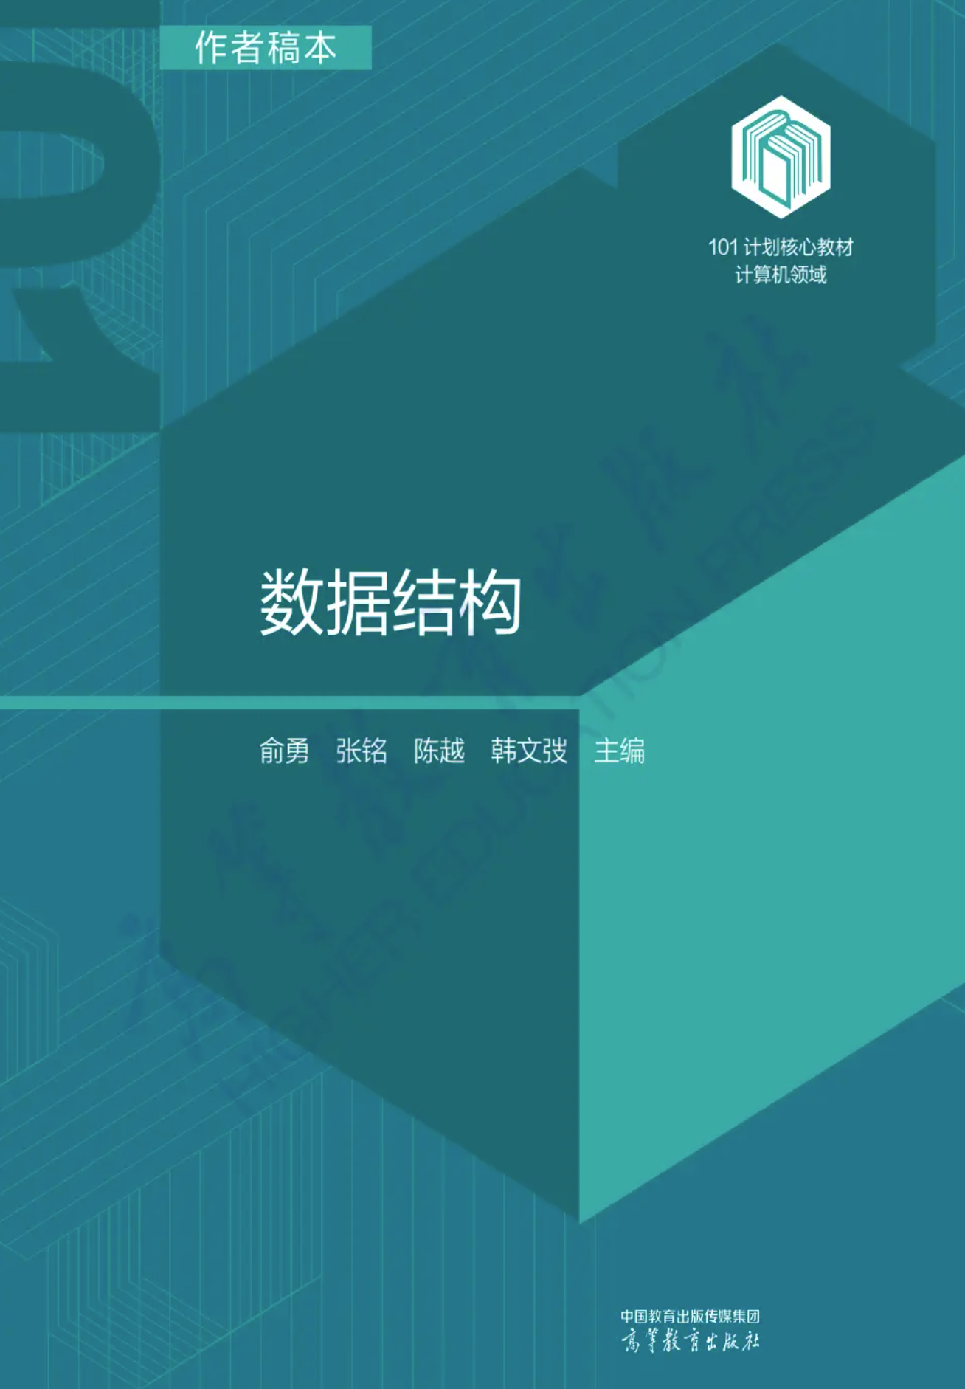
101计划教材
2021年末，教育部在北京大学启动实施了计算机领域本科教育教学改革试点工作计划，这项本科教育教学改革试点工作由图灵奖得主约翰·霍普克罗夫特教授提议、教育部统筹部署、高教司牵头，被称为“101计划”
“101计划”的目标是：用两年时间推出一批计算机领域的名课、名师、名教材。针对12门计算机专业核心课程，组成顶尖师资团队，对课程的内容、讲授方式、实践平台进行全面建设，引领带动高校计算机人才培养质量的整体提升
《数据结构》，101计划教材
电子书：https://ebook.hep.com.cn/index.html
计算机学科101计划
工作组牵头单位：北京大学
工作组组长：胡振江教授，北大计算机学院院长
课程建设组负责人：郭耀教授，北大计算机学院教学副院长
课堂提升组负责人：陆俊林教授，北大信息科学技术学院教学副院长

Slide 6
Grading
考试 60%
期中+期末笔试：20分 + 25分
POJ机考: 15分
平时 40%
MOOC 15分：
http://www.icourse163.org/course/PKU-1002534001
基本概念、算法填空、Quiz小测、期中期末
Presentation（25分）OR
编程练习 10分：POJ + 书面作业 15分：
POJ与书面作业各11次
教学团队可能会根据实际教学情况对成绩评定比例进行微调

Slide 7
Grading(上机考试)
时间：期中笔试之后，某个周三3-4节，随堂考试
地点：计算中心机房 + 信科学院机房
题量：2.5小时，5道编程题，每题100分，总计500分
ICPC规则，但每题均有部分分
编程语言：POJ支持的语言均可，但所有语言的时间与内存限制一样；提供C++代码包
上机分数对应的总评分数：以200为界，采用不同的线性给分方式
上机200分以下部分（含200分），每个上机分对应0.045总评分；
超过200分部分，每个上机分对应0.02总评分
教学团队可能会根据实际教学情况对成绩评定比例进行微调

Slide 8
Grading
过往实验班成绩
 | 2020年 | 2021年 | 2022年
优秀率 | 85.73% | 81.25% | 96.65%
平均分 | 91.47 | 88.75 | 92.02
中位数 | 94 | 90 | 92.5

Slide 9
Presentation
Any interesting data structures and algorithms beyond the course scope
Design, analysis, optimization, and applications
~20 min

Slide 10
Selected Presentation Topics
高级数据结构
堆的变种（二项、斐波那契、Treap等）
散列函数及其衍生（Cuckoo hash，一致性散列）
SIFT特征识别算法
ZKW线段树
K维数点
后缀自动机
概率算法
数据结构的实际应用
Linux内核中的数据结构
P2P系统中的散列策略
搜索引擎中索引数据结构
Log structure merge tree
AI驱动的数据结构与算法

Slide 11
Today’s Outline
Basic Concepts
Complexity and Hardness
Beyond the Scope

Slide 12
Algorithms + Data Structures = Programs
Niklaus Wirth (1934 - )
Turing Award Winner, 1984

Slide 13
Algorithm
A finite sequence of computer-implementable instructions
To solve a problem or to perform a computation
https://en.wikipedia.org/wiki/Algorithm

Slide 14
Data Structure
The way of data organization in a computer
To support specific operations efficiently

Slide 15
Algorithm + Data Structure
Data structures and algorithms are highly related
Example
find smallest element in a collection of n values
Different data structures
Plain data (no organization)
Sorted structure
Min-Heap

Slide 16
Abstract Data Type (ADT)
Defined from the perspective of users
Set of data values (objects)
Relationship among data values
Supported operations on data values
Regardless of
Implementation details

Slide 17
ADT VS Data Structure
ADT
Definition of a data collection
Logical form
Data structure
Implementation of a data collection
Physical form

Slide 18
Why Need Data Structure Course?
Especially when we have already had STL (and Boost) containers and algorithms?
At least, you should know the most suitable containers and algorithms, given a problem to solve

Slide 19
Why Need Data Structure Course?
Moreover,
STL is designed for general purpose use
In another word, it is not suitable for every case
If some specific cases, we have to develop our own data structures…
A graph distributed in multiple machines?
SSD-aware data structure for lifetime extension?
A queue that has to return items with hard real-time constraints?
Specific hardware restrictions (switches, sensors) ?
We need to know about the underlying details, and know to analyze and identify the performance/energy hotspots for optimization

Slide 20
Extension: Google’s Data Structure
Google File System (2003)
Log data and webpage data in thousands of machines (reduce costs)
Handle machine faults (robust)
Support Google’s workload
From data structure’ view
No specific structure
Only travel and append operation
Cannot even random access
https://static.googleusercontent.com/media/research.google.com/en//archive/gfs-sosp2003.pdf

Slide 21
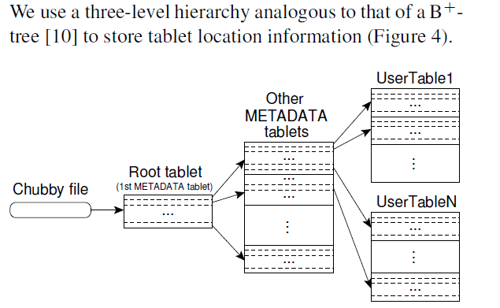
Extension: Google’s Data Structure
Google Big Table (2006)
Key-value data access
Applications: Google Analytics, Google Earth, Personalized Search
From data structure’ view
Hash table + B+ Tree
https://static.googleusercontent.com/media/research.google.com/en//archive/bigtable-osdi06.pdf

Slide 22
Extension: Google’s Data Structure
Google Dremel (2006)
Real-time data access
Query PB data within a few seconds
Google Spanner (2012)
Global database
Both are supported by internal data structures and algorithms
https://static.googleusercontent.com/media/research.google.com/en//pubs/archive/36632.pdf
https://static.googleusercontent.com/media/research.google.com/en//archive/spanner-osdi2012.pdf

Slide 23
Today’s Outline
Basic Concepts
Complexity and Hardness
Complexity
Complexity classes
Beyond Course Scope

Slide 24
Evaluate An Algorithm
Given an algorithm of size n, how to tell whether it is efficient?
Common metrics
Time cost: T(n)
Space cost: S(n)
More metrics
Energy consumption
Financial investment (e.g., specific hardware)
Implementation

Slide 25
Asymptotic Complexity (渐进复杂度)
DSA course: time and space cost
Sometimes we also address implementation difficulty
A platform-independent, instance-independent, and predictable metric
Evaluate the trend how runtime/space grows with respect to problem size

Slide 26
Big-O Notation (Upper Bound)
f(n) = O(g(n))
iff ∃ c, n₀ > 0, s.t. ∀ n≥n₀: 0 ≤ f(n) ≤ c·g(n)
c·g(n)
f(n)
n
n₀

Slide 27
Big-Ω Notation (Lower Bound)
f(n) = Ω(g(n))
iff ∃ c, n₀ > 0, s.t. ∀ n≥n₀, 0 ≤ c·g(n) ≤ f(n)
f(n)
c·g(n)
n₀
n

Slide 28
Big-Θ Notation
f(n) = Θ(g(n))
iff ∃ c₁,c₂,n₀>0, s.t. ∀ n>n₀: 0≤c₁g(n)≤f(n)≤c₂g(n)
c₂g(n)
f(n)
c₁g(n)
n₀
n

Slide 29
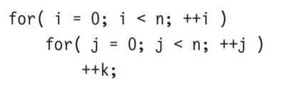
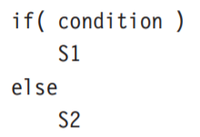
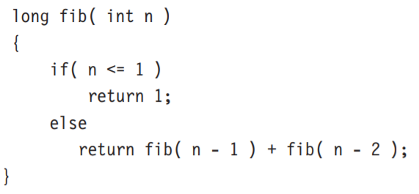

How to
For Loops
If / Else
Recursion

Slide 30
Asymptotic Complexity (渐进复杂度)
Eventually only big-Θ is expected
Big-O and big-Ω are used when human’s knowledge on the complexity of a problem is not complete
Big-O: resources (time and space) needed
Big-Ω: how best we can reach

Slide 31
Exercise
The complexity of the following function?
void recursive(int n, int m, int k) {
if (n <= 0)
printf("%d, %d\n", m, k);
else {
recursive(n-1, m+1, k);
recursive(n-1, m, k+1);
} }
A. O(n*m*k) B. O(n^2*m^2) C. O(2^n) D. O(n!)

Slide 32
Complexity Depends on Input
Input size n is a rough description
According to different input of the same size
Best-case complexity
Worst-case complexity
Average-case complexity
Real-world applications have inherent input distributions
E.g. power-low distribution (80-20 effect)
Calculate average-case complexity accordingly

Slide 33
But… the Constant Matters Sometimes
The big-O notation assumes a memory access and a computation are both O(1)
“memory”: O(1), O(10), O(100)
Reasons for external data structures and algorithms
Reducing the constant factor is helpful
Reduce the runtime from 10 days to 1 day when reducing from O(10) to O(1)

Slide 34
Example
QuickSort:
Average: O(n*log n)
Worst: O(n^2)
MergeSort
Average: O(n*log n)
Worst: O(n*log n)
HeapSort
Average: O(n*log n)
Worst: O(n*log n)

Slide 35
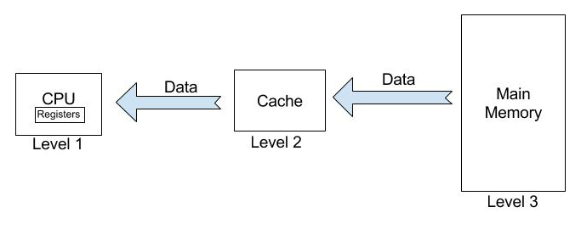
Example
In practice, QuickSort is 2x or 3x faster than MergeSort and HeapSort
Reason
QuickSort has better cache locality
Few extra memory & many sequential access
Most data access occur in cache instead of main memory

Slide 36
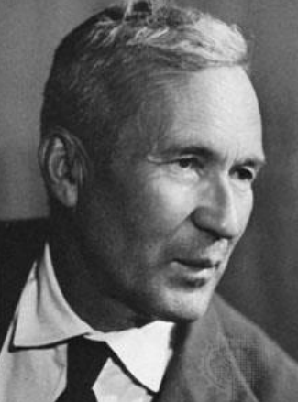
About Implementation Difficulty
No formal way to quantify
Typically, we consider
# of branches
Lines of Code
Kolmogorov Complexity
Quantify the hardness of describing an object
A program can be an object
However, program ≠ algorithm
Kolmogorov (1903-1987)

Slide 37
Today’s Outline
Basic Concepts
Complexity and Hardness
Complexity
Complexity classes
Beyond Course Scope

Slide 38
Complexity Classes
Classify problems based on hardness
Informal notation: whether efficient algorithms exist to solve/verify/transform …
P, NP, NP-hard, NP-complete…

Slide 39
An Informal Tutorial on P vs. NP
P (polynomial)
Problems that can be solved in polynomial time by a deterministic Turing machine
NP (nondeterministic polynomial)
Definition 1: problems whose solutions can be verified by a deterministic Turing machine in polynomial time
Definition 2: problems that can be solve in polynomial time by a non-deterministic Turing machine
The two definitions are equivalent
P is a subset of NP

Slide 40
An Informal Tutorial on P vs. NP
Problem A is “harder” than problem B
If problem B can be solved in polynomial time, given a O(1) solver (referred as “Oracle”) of problem A
Problem B can be reduced to Problem A
NP-hard
Problems that are as least as hard as the hardest NP problems
NP-complete
= NP-hard ∩ NP

Slide 41
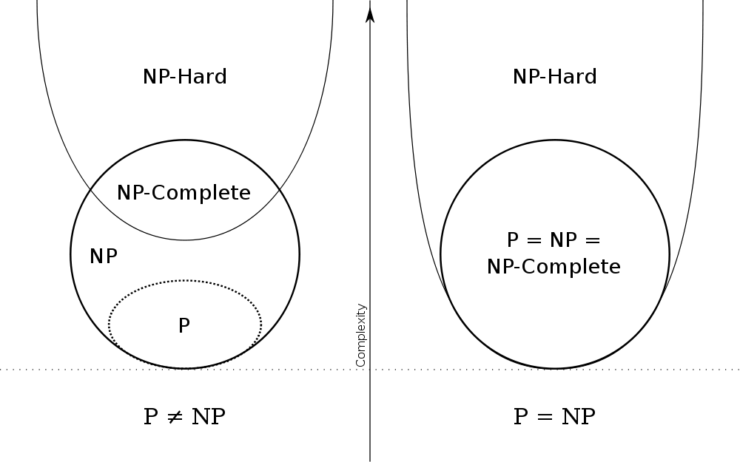
Neutral Point of View on P vs. NP
http://en.wikipedia.org/wiki/File:P_np_np-complete_np-hard.svg

Slide 42
Classical Problems
Any problems that are in NP, not known to be in P, and not known to be NPC?
Graph isomorphism
Integer factoring
Discrete log
…
http://blog.computationalcomplexity.org/2010/07/spares-problems-in-np-thought-to-not-be.html
Notes:
Factoring in RSA; Discrete log in ElGamal Crptosyste,, Diffie-Hellman key exchange (e.g., PGP).

Slide 43
But, In practice
(1) Some NP-hard problems are solvable in practice because their input size is not too large

Slide 44
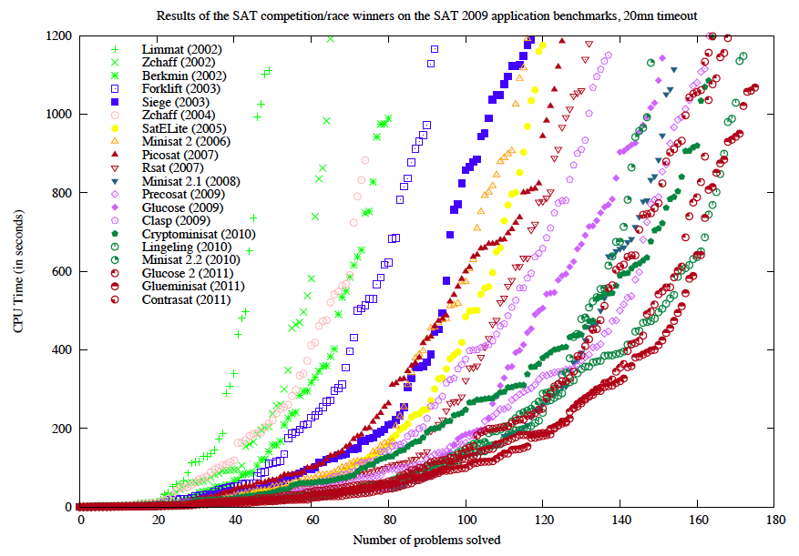
Example: SAT Problem
An application instance typically contains 10⁷ variables and clauses
Cook Theorem:
All NP Problem can be reduced to SAT in polynomial time
链接：解决中国“卡脖子”问题：研究求解器的少数者
Jarvisalo et al., “The International SAT Solver Competitions,” AI Magazine 2012.
Notes:
CCASat（蔡少伟、苏开乐等）获SAT Challenge 2012 Radom SAT track第一名。

Slide 45
But, In practice
(2) Some NP-hard problems accept approximate results

Slide 46
Example
Bin packing problem: NP-complete
n items, each has its weight
m bins, each has its capacity
problem: minimize the number of bins to fit the n items
Many real-world problem
Do not need to find optimal solution (i.e., the minimum number of bins)

Slide 47
More Thinking
0-1 bin packing problem
Solvable with dynamic programming
Is it contradict with NP-completeness of bin packing?

Slide 48
More Thinking
0-1 bin packing
Input:
n items with their weights c₁, c₂, …, c_{n}
Total weight: W
Time complexity: O(nW)
Total # of bits in input: log n + n log W
If c_{i} < W for all i
Exponential time!
Pseudo-polynomial time
Time complexity contains values of input
NP-completeness
Weak NPC: can be solved in psudo-polynomial time
Strong NPC: cannot be solved in psudo-polynomial time

Slide 49
But, In practice
(3) Some problems are not known whether they are NP-hard, but we consider them “difficult problem” in practice

Slide 50
Example
Primer factorization
Basis of modern cryptography
E.g., RSA cryptography

Slide 51
Today’s Outline
Basic Concepts
Complexity and Hardness
Beyond Course Scope
Randomized Algorithms
Online Algorithms

Slide 52
In This Course, We Focus On
Deterministic data structures and algorithms
“Off-line” algorithms
But more data structures and algorithms in practice

Slide 53
Randomized Algorithms
Introduce some randomness during the execution
Sherwood: always return correct answers, but complexity varies
Example: Optimized QuickSort
Monte Carlo: have a chance of producing wrong answers
Example: Bloom Filter
Las Vegas: never return wrong answers, but sometimes fail to return answers
Example: Randomized 8-queens problem

Slide 54
An Example: Bloom Filter
ADT:
Data: a set of elements A
Support operation: has_member (x)
testing whether an element x is a member of the set A
Naïve approach: exactly record every element
An element needs w bits (w > 100 in practice)
At least w*n bits in total

Slide 55
An Example: Bloom Filter
Design
Space-efficient probabilistic data structure for
Map elements in a m-bit array using k hash functions
Insertion & Query
Deletion?

Slide 56

An Example: Bloom Filter
Analysis
No false negatives
False positives
n: number of existing elements
k: number of hash functions
m: array size
Prob of not occupied by all prev hash
Prob of not occupied by one hash

Slide 57


An Example: Bloom Filter
Optimal Parameters
Given m and n, optimize k to minimize false positive (FP)
9.6 bits per element to limit FP under 1%
Applications
Google Bigtable and Hbase
Chrome: accelerating secure browsing
Spam filter
➔
➔ FP = 0.6185^{m/n}

Slide 58
Bloom Filter is Beautiful
Easy operations
Simple insertion, query, and deletion
Elegant in math
Trackable analysis and optimization
Wide applications and impact
Solve an important problem in the era of big data

Slide 59
Today’s Outline
Basic Concepts
Complexity and Hardness
Beyond Course Scope
Randomized Algorithms
Online Algorithms

Slide 60
Online Algorithms
Offline Algorithm: static input
Get entire input data in advance
Online Algorithm: dynamic input
Data is a sequence of items
Have not idea on future items
Usually process items one by one
Input Data
Output Data
Online Algorithms
Online Data Structure

Slide 61
Example
Online task schedule
Worker 1
Online Algorithm
Worker 2
Task Scheduler
…
Worker n

Slide 62
Today’s Summary
Basic Concepts
Algorithms, data structures, ADT
Complexity and Hardness
Big-O, Big-Ω, Big-Θ
P, NP, NP-hard, NP-complete
Practical issues
Beyond Course Scope
Randomized Algorithms
Online Algorithms

